Slide 1

FINAL PROJECT PRESENTATION
Healthcare – Persistency of a drug

Slide 2
Performer's Details
Name: Kseniya Kudzelich
Email: ksusha.konstovich@gmail.com
Country: Belarus
Specialization: Data Science
Internship Batch: LISUM34
August 29, 2024

Slide 3

Agenda
Business Understanding
Data Understanding
Exploratory Data Analysis
Proposed Modeling Technique
Modeling and Evaluation

Slide 4
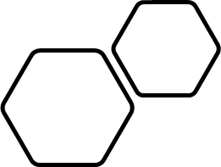
Business Understanding
Problem statement
One of the challenge for all Pharmaceutical companies is to understand the persistency of drugs as per the physician prescription. To solve this problem ABC pharma company would like the process Automated.
Objectives
The overall aim of the analysis part of the project is to provide insights into factors that impact the persistency of drugs, which afterwards will lay the foundation on building a suitable classification model and also propose some modelling technique to be used.
Business Understanding
Pharmaceutical company ABC Pharma is interested in identifying the key factors that influence whether patients persist with their medication. By leveraging machine learning to predict persistency, the company can develop strategies to improve adherence rates.

Slide 5
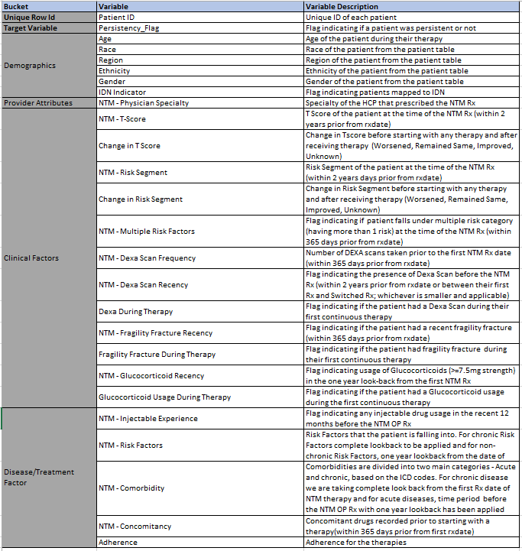
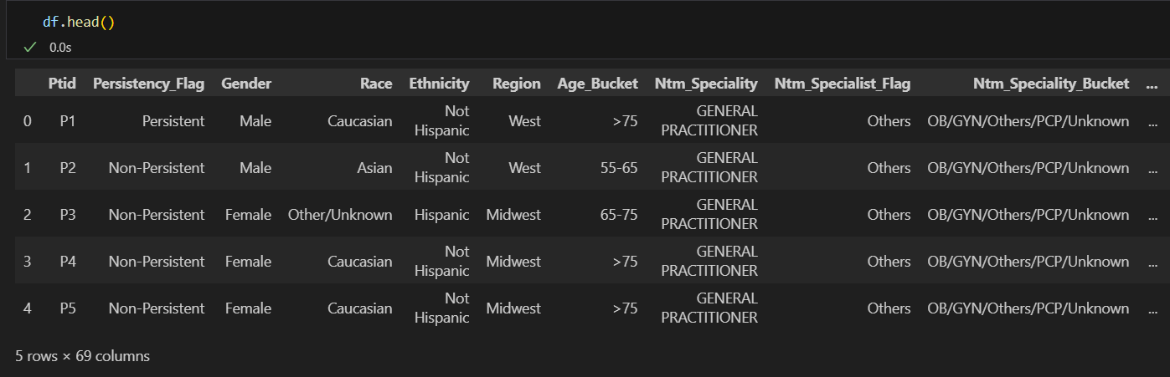
Data Understanding
The dataset contains 3424 rows and 69 columns.

Slide 6
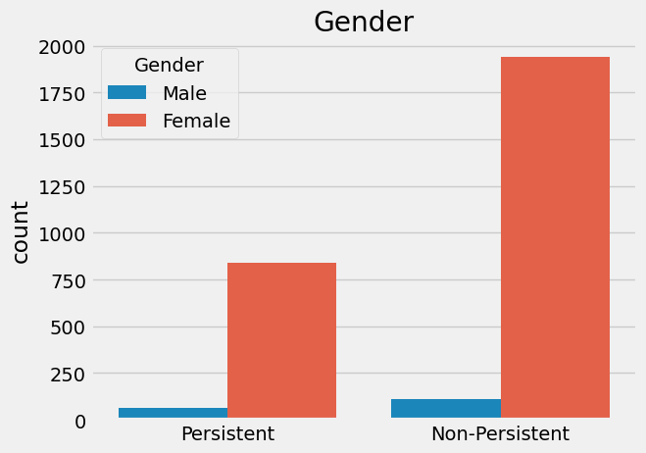
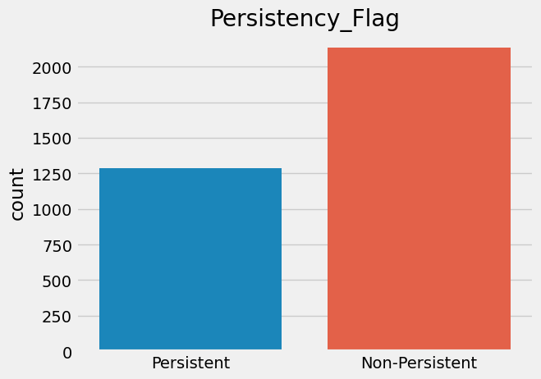
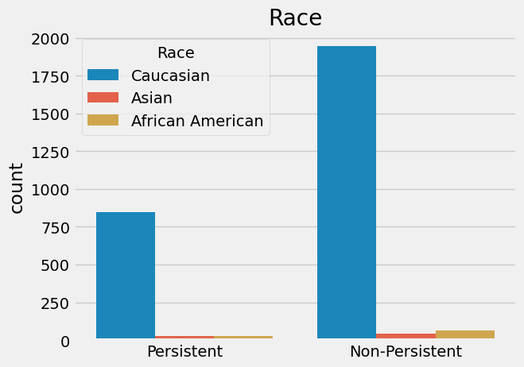
Exploratory Data Analysis
People of Caucasian race when compered to other races are the most common in the study.
Significantly more patients are into the Non-Persistent group compared to the Persistent group.
The dataset reveal that females significantly outnumber males in both groups.

Slide 7

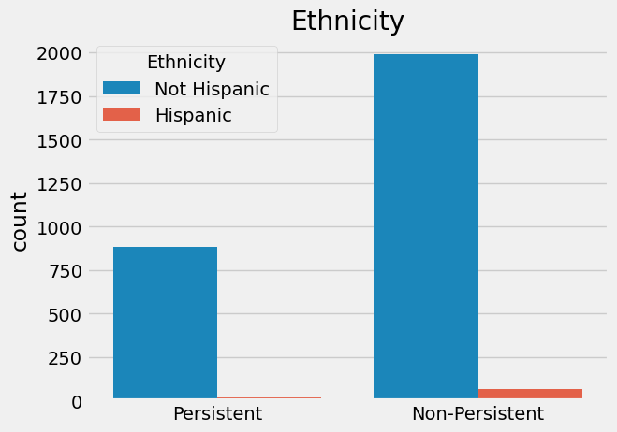
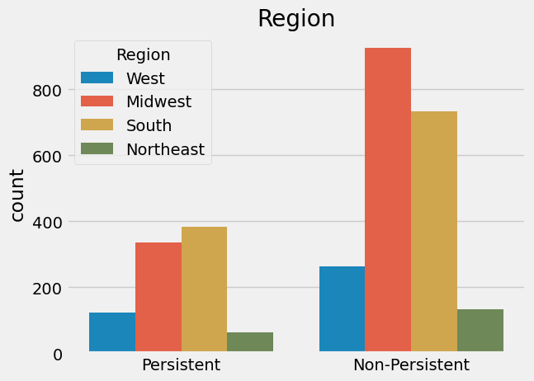
Exploratory Data Analysis
The non-Hispanic ethnic group is the most common in the study.
Patients from the Midwest and South regions dominate both groups.

Slide 8
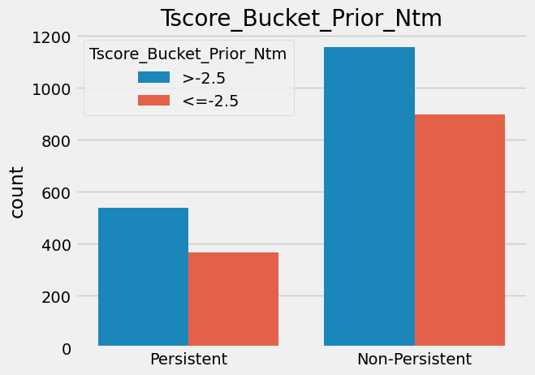
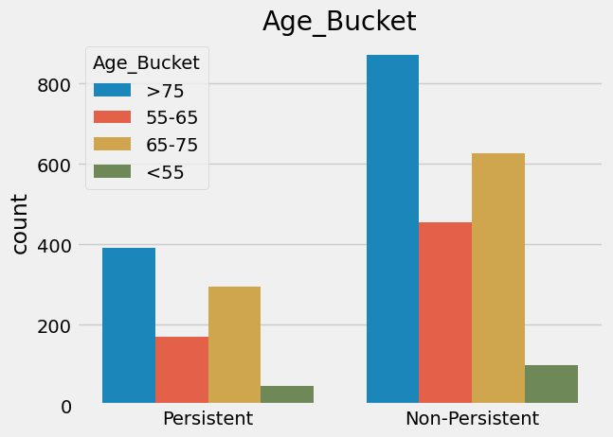
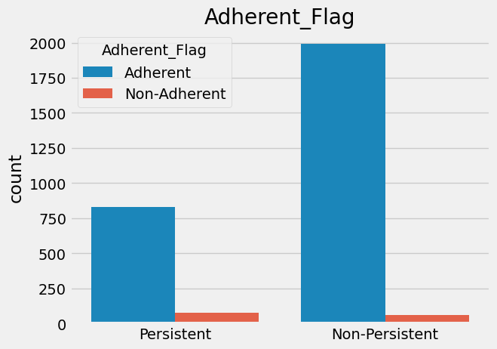
Exploratory Data Analysis
For this study, patients older than 75 make up a significant portion of both groups.
Patients with a T-score greater than -2.5 are more common in both groups.
Both groups Persistent and Non-Persistent have significantly more patients who follow the prescriptions (Adherent). Most patients who are labeled as Adherent (following prescriptions) still fall into the Non-Persistent category, indicating other factors affect long-term treatment persistence.

Slide 9
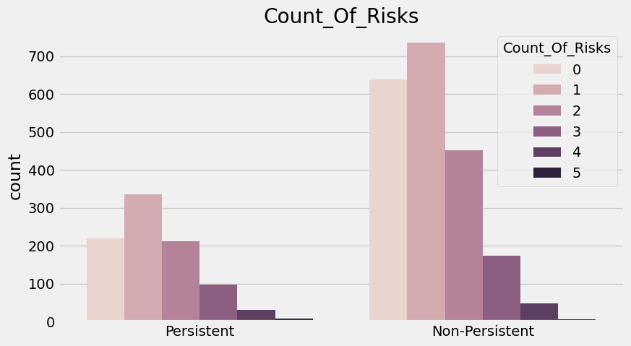
Exploratory Data Analysis
Patients with 0, 1 and 2 risks predominate in both Persistent and Non-Persistent groups with the highest concentration at 1 risk.

Slide 10
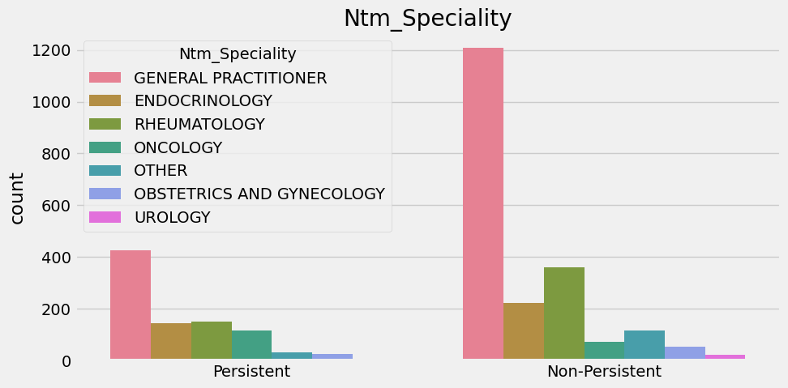
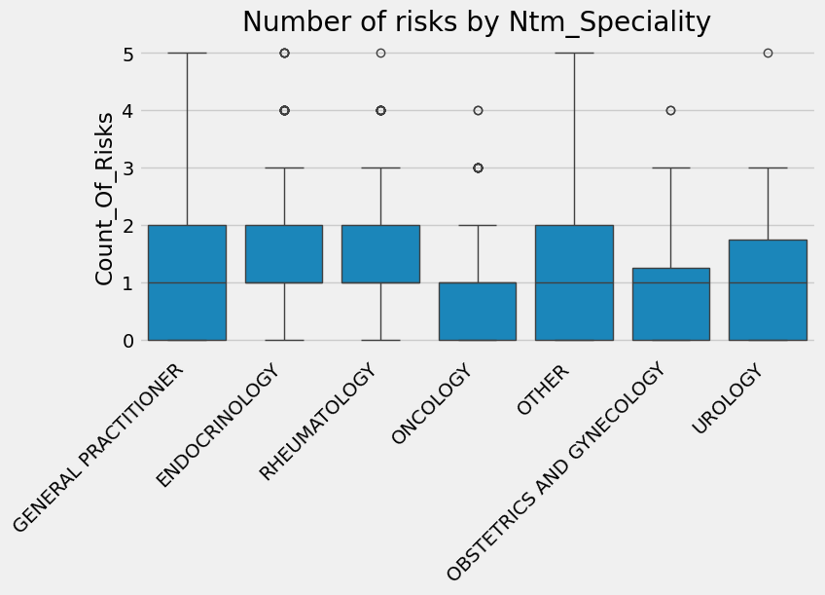
Exploratory Data Analysis
Patients seen by General Practitioners and Rheumatologists tend to have a wider distribution of risks, including higher numbers, compared to seen by specialists in other fields.
General Practitioner speciality prevail in both groups.

Slide 11
EDA Summary
EDA SUMMARY
The dataset contains 3424 rows and 69 columns.
Significantly more patients are into the Non-Persistent group compared to the Persistent group.
The dataset reveal that females significantly outnumber males in both groups.
The majority of patients in both groups are Caucasian.
The non-Hispanic ethnic group is the most common in the study.
Patients from the Midwest and South regions dominate both groups.
Patients older than 75 make up a significant portion of both groups.
Both groups Persistent and Non-Persistent have significantly more patients who follow the prescriptions (Adherent).
Most patients who are labeled as Adherent (following prescriptions) still fall into the Non-Persistent category, indicating other factors affect long-term treatment persistence.

Slide 12
Proposed Modeling Technique
PROPOSED MODELING TECHNIQUE
Data Preprocessing: encode categorical variables and normalize numerical features to ensure consistency and equal contribution to the model.
Model selection: since, from the point of view of machine learning, the task is to perform a binary classifier (persistent or non-persistent), we recommend testing models for the prediction, taking into account interpretable and simple models as well.
Therefore, we will try the following models:
1. Logistic Regression
2. Support Vector Machine
3. Decision Tree
4. Random Forest
5. Gradient boosting (LightGBM or XGBoost)
6. KNN

Slide 13
Proposed Modeling Technique
PROPOSED MODELING TECHNIQUE
Model evaluation: use cross-validation, performance metrics (accuracy, precision, recall, F1-score), and confusion matrix analysis to comprehensively evaluate model performance.
Hyperparameter tuning: Employ grid search for tuning.
Interpretation and Validation: Use SHAP values or another method for model interpretation, and validate the model on test data to ensure generalizability.

Slide 14
Modeling and Evaluation
Modeling and Evaluation
The results on the test dataset:
Model | F1-score (weighted) | Accuracy
Logistic Regression | 0.82 | 0.83
SVM | 0.81 | 0.81
Decision Tree | 0.77 | 0.78
Random Forest | 0.82 | 0.83
LGBM | 0.79 | 0.80
KNN | 0.78 | 0.80
It is turned out that Logistic Regression and Random Forest models are the best performing models within our data.
As a result, Logistic Regression was chosen as a final model, because it is faster than Random Forest.

Slide 15
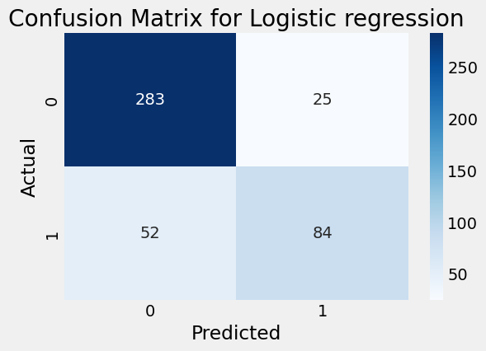
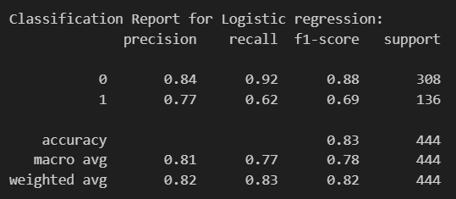
Modeling and Evaluation
Logistic Regression
Regularization has been applied
F1-score: 82%, Accuracy: 83%

Slide 16
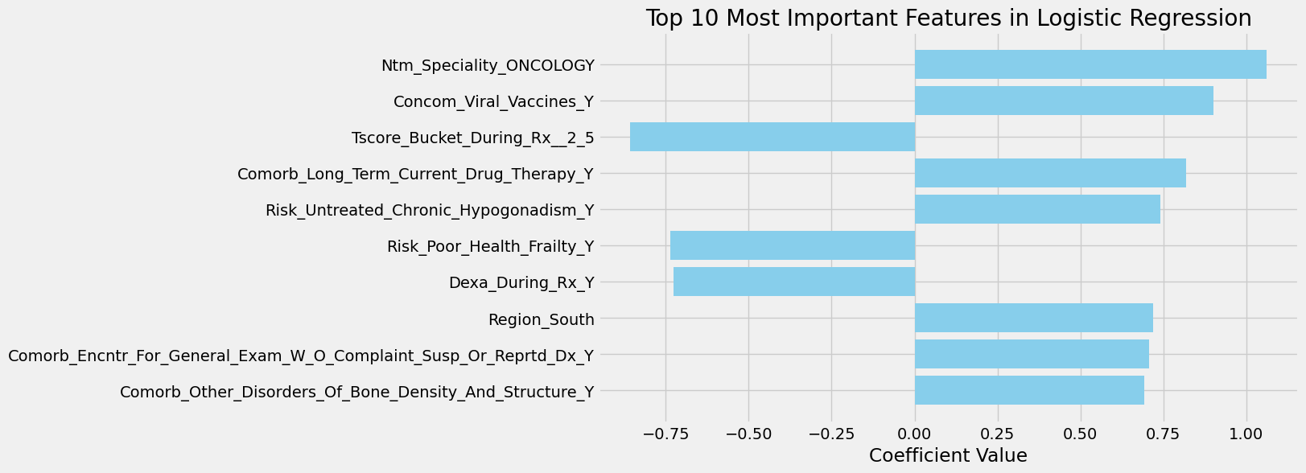
Modeling and Evaluation
Feature Importance
The most important features of the model include the patient's belonging to the specialty "Oncology“, receiving viral vaccines, undergoing long-term current drug therapy, and having untreated chronic hypogonadism, which significantly increase the probability of a positive outcome.
Negative coefficients indicate the negative impact of a health condition, such as T-score results, poor health frailty, and Dexa scan during treatment on the outcome.
The region of residence and specific medical examinations also influence the predictions of the model, though to a lesser extent.
These results highlight the importance of taking into account medical and regional factors when assessing the likelihood of certain outcomes and developing a treatment strategy.

Slide 17
Repository details
Repo link: GitHub repo

Slide 18

Thank You!

